Slide 1
Banking Law 2 Origin of banking in Kenya
andyconie@gmail.com or andy@cuea.edu

Slide 2
Origin of banking
The financial journey in Kenya dates back to the pre-colonial periods. At first, the pioneering banks concentrated on financing international trade along the Europe-South Africa–India axis.

Slide 3
Origin of banking Cont
They, however, soon diversified operations to tap the opportunities for profitable banking created by a growing farming settler community and pioneer traders in the local economy to whom they provided deposit and credit facilities.
It was only a matter of time for banking to spread into the interior.

Slide 4
Origin of banking Cint
It all started with Indian money lenders operating quasi bank services probably as early as the 18th century but the first recognisable bank was Jetha Lila Bankers from India, which was established in Zanzibar in 1880.

Slide 5
Origin of banking
In 1889 the National Bank of India appointed the trade house of Smith Mackenzie to be their agent in Zanzibar.
Smith Mackenzie had a Mombasa branch in 1887 which was taken over by the Imperial British East Africa (IBEA) in 1888.

Slide 6
Origin of banking Cont
The National Bank of India established its own office in Zanzibar in 1892.
In July 1896 the National Bank of India established a branch in Mombasa renting premises from Sheriff Jaffer.
The spread continued to 1904 when they opened a branch in Nairobi.

Slide 7
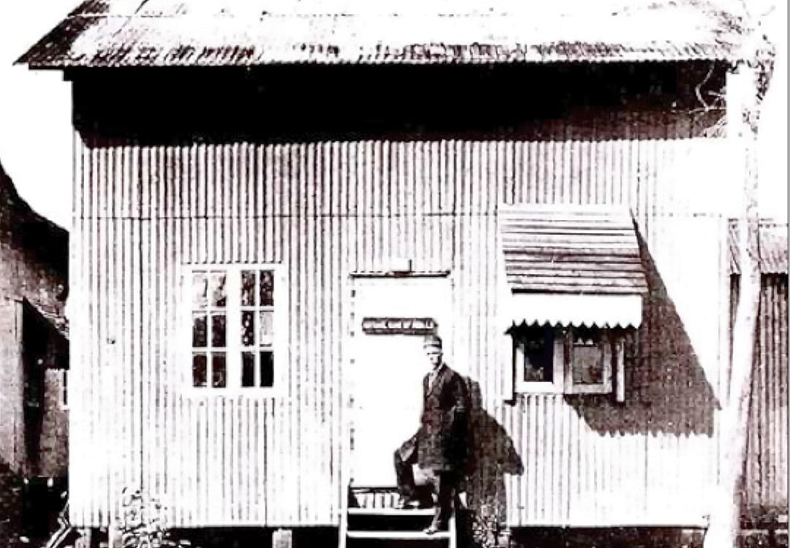
1904 National Bank of India NBI

Slide 8
Banking law
In April, 1909, the East Africa Post Office Savings Bank Ordinance was passed and in April of the following year, the Ordinance for the Regulation of Banks Established or to be Established in the East Africa Protectorate was passed.
The former Ordinance established the first bank in the formal sense while the latter enabled the National Bank of India to become the first commercial bank.

Slide 9
Banking growth
By 1911 there were only three banks:-
The National Bank of India with branches in Mombasa, Nairobi, Nakuru and Kisumu.
The Standard Bank of South Africa having come in December, 1910 – operating in four locations: Mombasa (3 branches), Nairobi (2 branches), Nakuru and Kisumu.
Kathiawad and Ahmedabad Banking Corporation had a short-lived presence in Mombasa from 1910 to 1915.

Slide 10
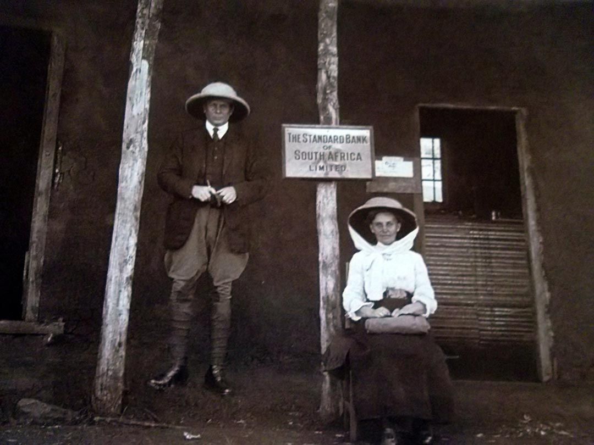
Standard Bank of SA Eldoret, 1912

Slide 11
Bank growth
The expansion of the banking networks grew from one branch in the town of Mombasa in 1896 and eight branches for NBI to five towns before the First World War having added Nairobi, Nakuru, Kisumu and Eldoret.

Slide 12
Bank Growth
The National Bank of South Africa, which was to become Barclays Bank DCO in 1926, arrived in Mombasa in 1916. During the Great Depression from 1929 to 1939, there was a gold rush to Kakamega and in 1934 there were two bank branches opened in the town to service the prospectors.
These branches did not survive and were closed during the Second World War.

Slide 13
Bank growth Cont
By 1948, banks were to be found in 10 towns having expanded to Nyeri, Nanyuki, Kitale, Kericho and Thompson’s Falls (Nyahururu) with 18 branches as Mombasa, Nairobi, Nakuru and Kisumu all got representation from the three banks.

Slide 14
Kenyan Banks
As time progressed, the changing landscape of banking began to note the entrance of fully indigenous banks.
Kenya’s first fully locally owned commercial bank was the Co-operative Bank of Kenya, which was initially a co-operative society.
It served the needs of growing farming communities and started operations in 1968.
In the same year, the National Bank of Kenya became the first fully-owned government bank.

Slide 15
Kenyan Banks Cont
In 1971, the Kenya Commercial Bank was formed following the merger of the National and Grindlays Bank, with the government owning a 60-per cent majority stake.
It took pole position as the largest of the country’s commercial banks in terms of deposits and number of branches-WHY WAS THIS SO?

Slide 16
Current banks in Kenya
ABC Bank (Kenya)
Bank of Africa
Bank of Baroda
Bank of India
Barclays Bank of Kenya
Chase Bank Kenya (In Receivership)
Citibank

Slide 17
Current banks in Kenya Cont
Commercial Bank of Africa
Consolidated Bank of Kenya
Cooperative Bank of Kenya
Credit Bank
Development Bank of Kenya
Diamond Trust Bank

Slide 18
Current banks in Kenya Cont
Dubai Islamic Bank
Ecobank Kenya
Equity Bank
Family Bank
First Community Bank
Guaranty Trust Bank Kenya
Guardian Bank

Slide 19
Current bank in Kenya Cont
Gulf African Bank
Habib Bank AG Zurich
Housing Finance Company of Kenya
I&M Bank
Imperial Bank Kenya (In receivership)
Jamii Bora Bank
Kenya Commercial Bank
Mayfair Bank

Slide 20
Current banks in Kenya Cont
Middle East Bank Kenya
National Bank of Kenya
NIC Bank
Oriental Commercial Bank
Paramount Universal Bank
Prime Bank (Kenya)
SBM Bank Kenya Limited

Slide 21
Current banks in Kenya Cont
Sidian Bank
Spire Bank
Stanbic Bank Kenya
Standard Chartered Kenya
Trans National Bank Kenya
United Bank for Africa
Victoria Commercial Bank

Slide 22
Reps Bank
Representative offices of foreign banks
HDFC Bank
Nedbank
FirstRand Bank
Bank of China
JP Morgan Chase
Bank of Kigali

Slide 23
Deposit Taking Microfinance
Faulu Kenya
Choice Microfinance Bank Limited
KWFT – Kenya Women Microfinance Bank Ltd
SMEP Microfinance Bank Ltd
Musoni Microfinance Institution
Century Microfinance Bank Ltd
Uwezo Microfinance Bank Ltd

Slide 24

Micros

Slide 25
Micros
Rafiki Microfinance Bank Ltd
Remu Microfinance Bank Ltd
Sumac Microfinance Bank Ltd
U&I Microfinance Bank Ltd
Caritas Microfinance Bank Ltd (owned by the Catholic Church of Kenya)

